Slide 1
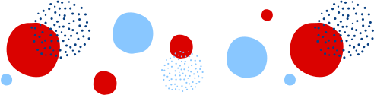

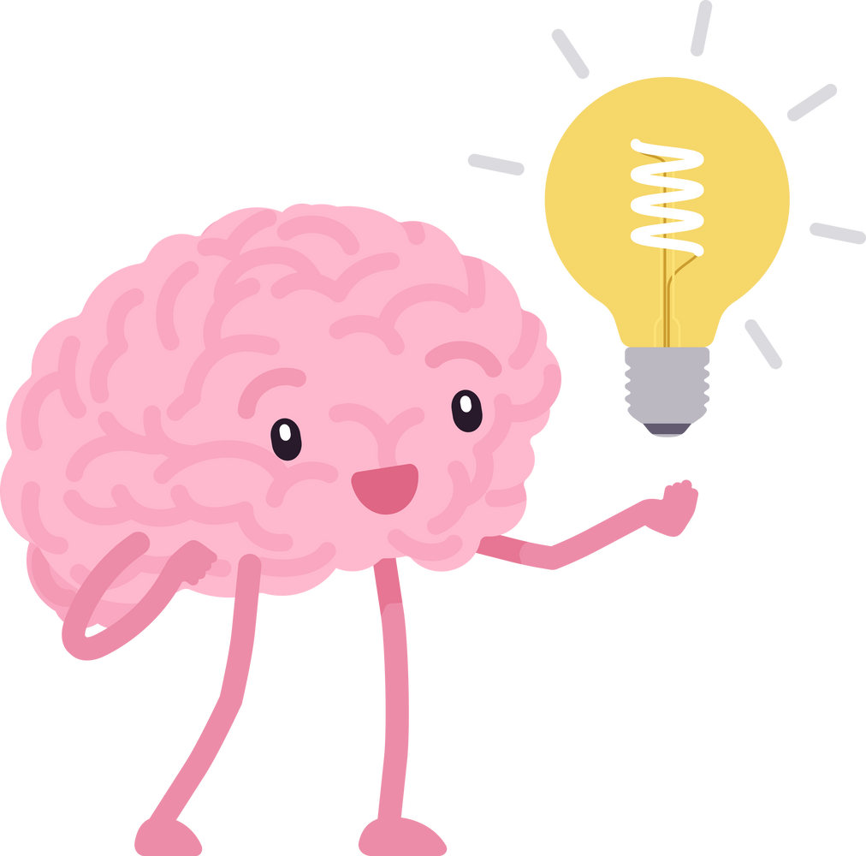
Verb To Be
Am - is - are

Slide 2

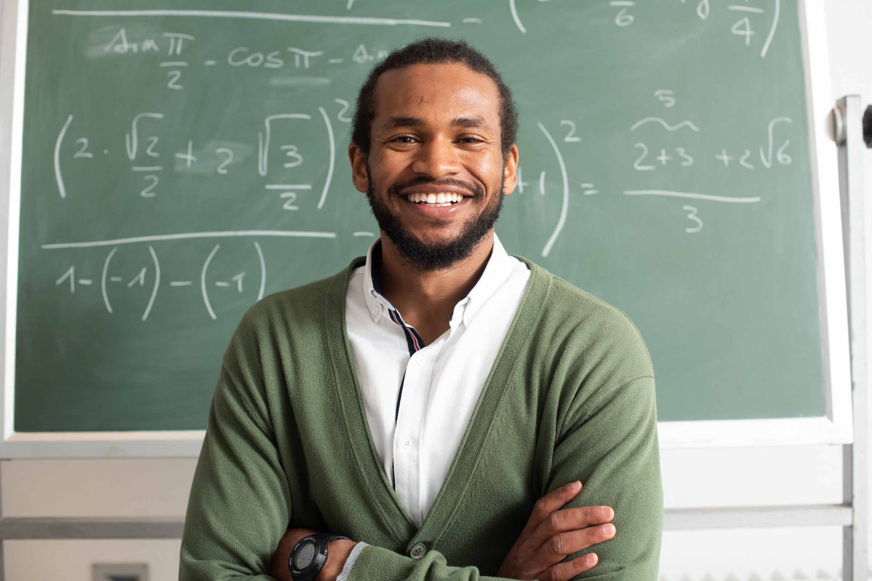

Ex: I am a teacher.

Slide 3
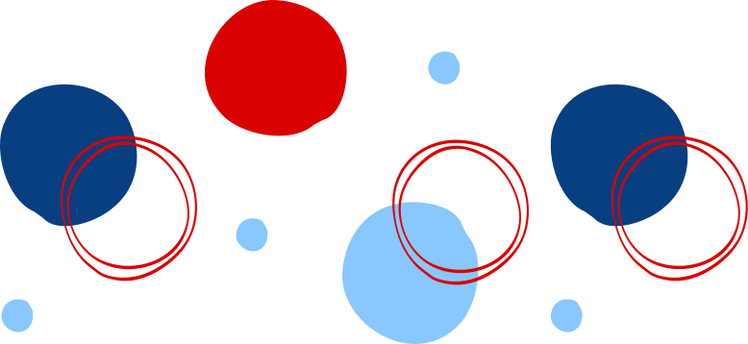
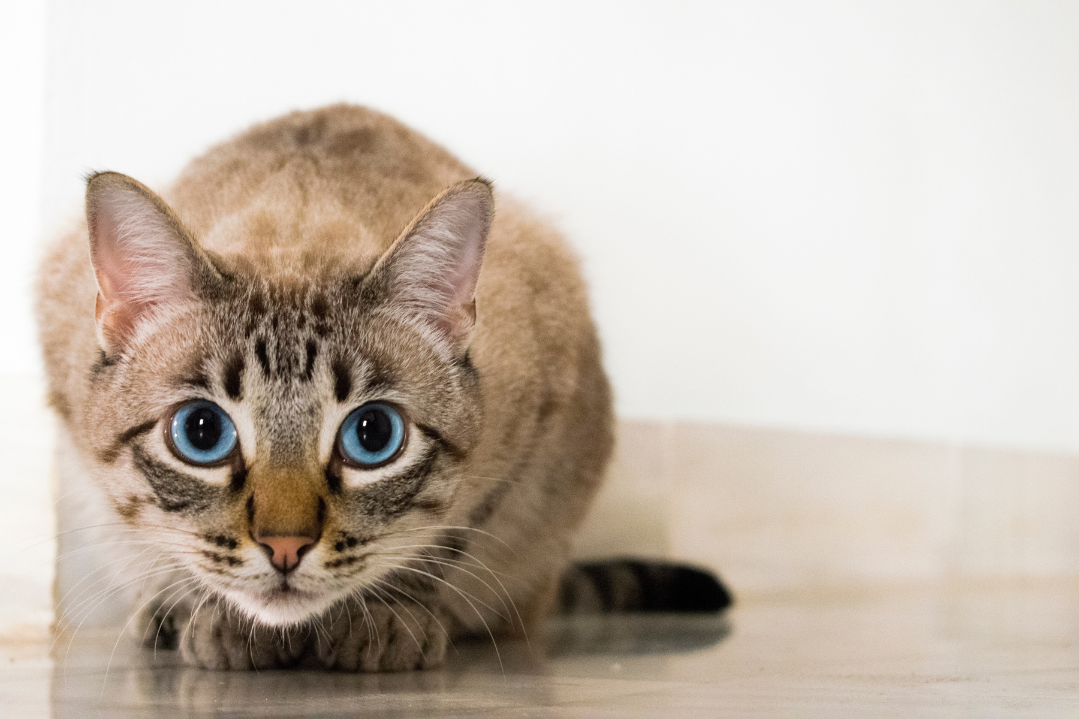

Ex: The cat is at home.

Slide 4





Subject pronoun
Português
I
He
She
It
You
We
They
Eu
Ele
Ela
Ele (a) Isto
Você(s)
Nós
Eles(as)
I ´m
´s
´re

Slide 5


Verb To Be: affirmative
Can you say a sentence with verb to be?

Slide 6




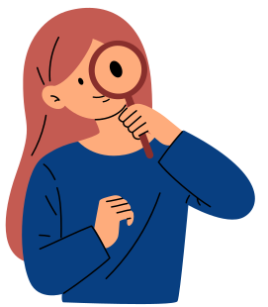
Long Form
Short Form
I
am
‘m
He
She
It
is
‘s
You
We
They
are
‘re

Slide 7




Verb To Be: negative
Can you say a sentence with verb to be in the negative?

Slide 8




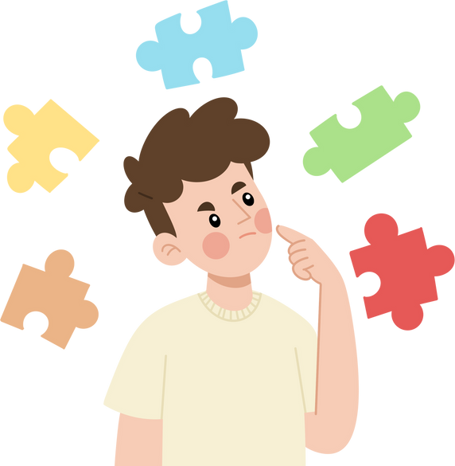

Long Form
Short Form
I
He
She
It
You
We
They
am not
is not
are not
I
He
She
It
You
We
They
’m not
isn’t
aren’t
I ´m
´s
´re

Slide 9



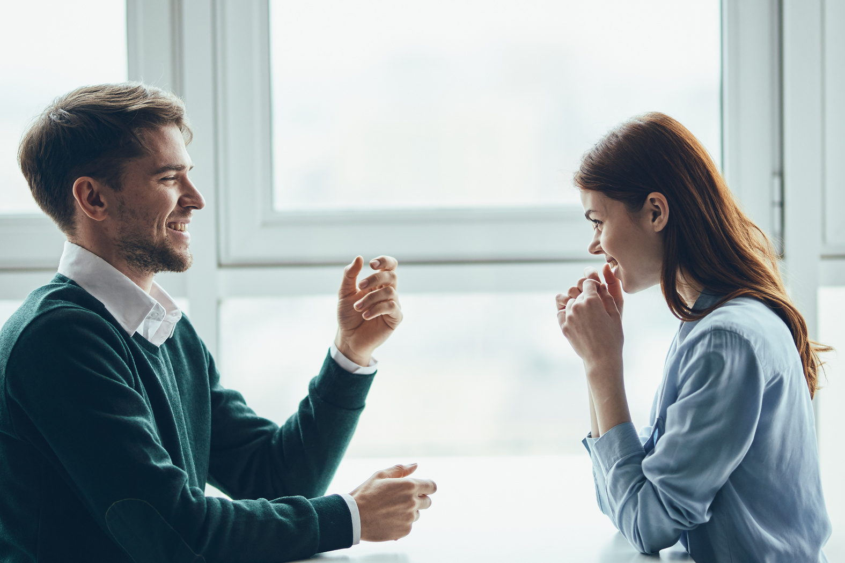
Verb To Be: questions and short answers
Are you
ready?
I’m not
sure!

Slide 10


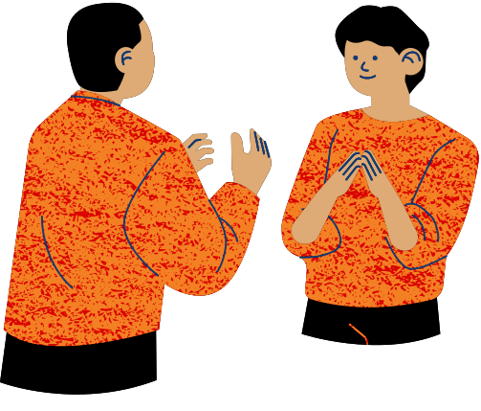
Questions
Short Answers
Am I ...?
Are you ...?
Is she ...?
Is he ...?
Is it ...?
Are you ...?
Are we ...?
Are they ...?
Yes, I am/ No, I'm not
Yes, you are/ No, you aren´t
Yes, she is/ No, she isn´t
Yes, he is/ No, he isn´t
Yes, it is/ No, it isn´t
Yes, you are/ No, you aren´t
Yes, we are/ No, we aren´t
Yes, they are/ No, they aren´t
I ´m
´s

Slide 11


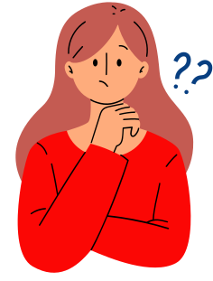

Let´s practice!
What´s the correct form of the verb?

Slide 12

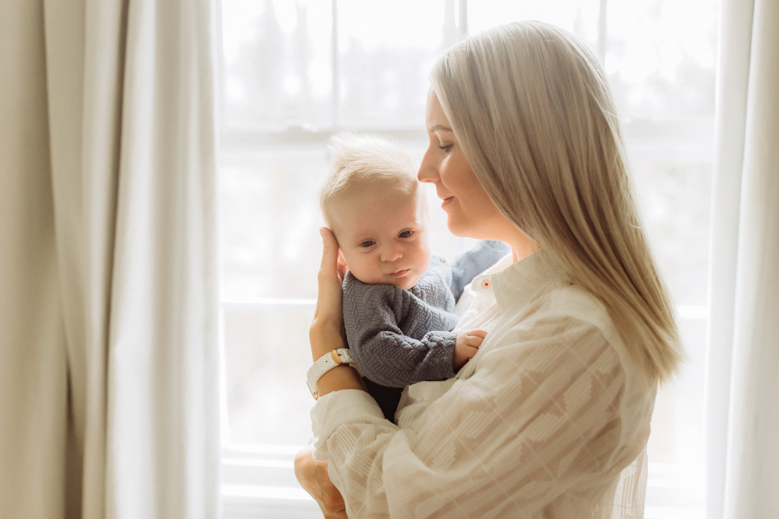
She ________________ my mum.

Slide 13
She ________________ my mum.
is

Slide 14

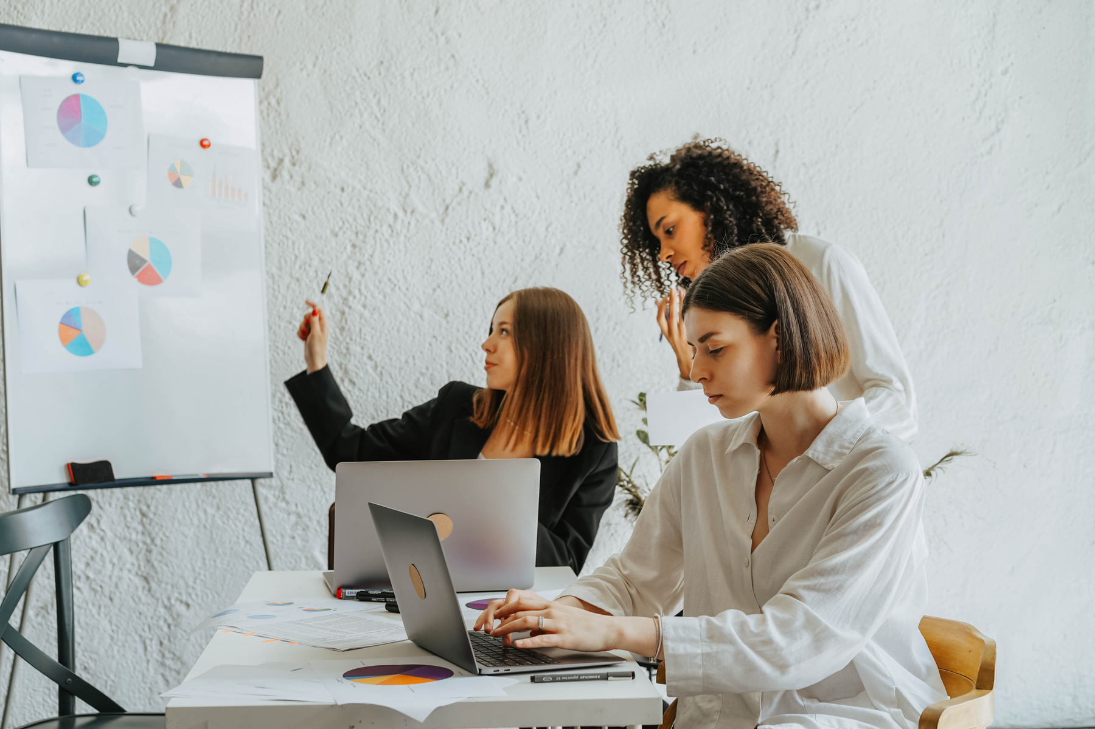

My friends ________________ at work.

Slide 15
My friends ________________ at work.
are

Slide 16
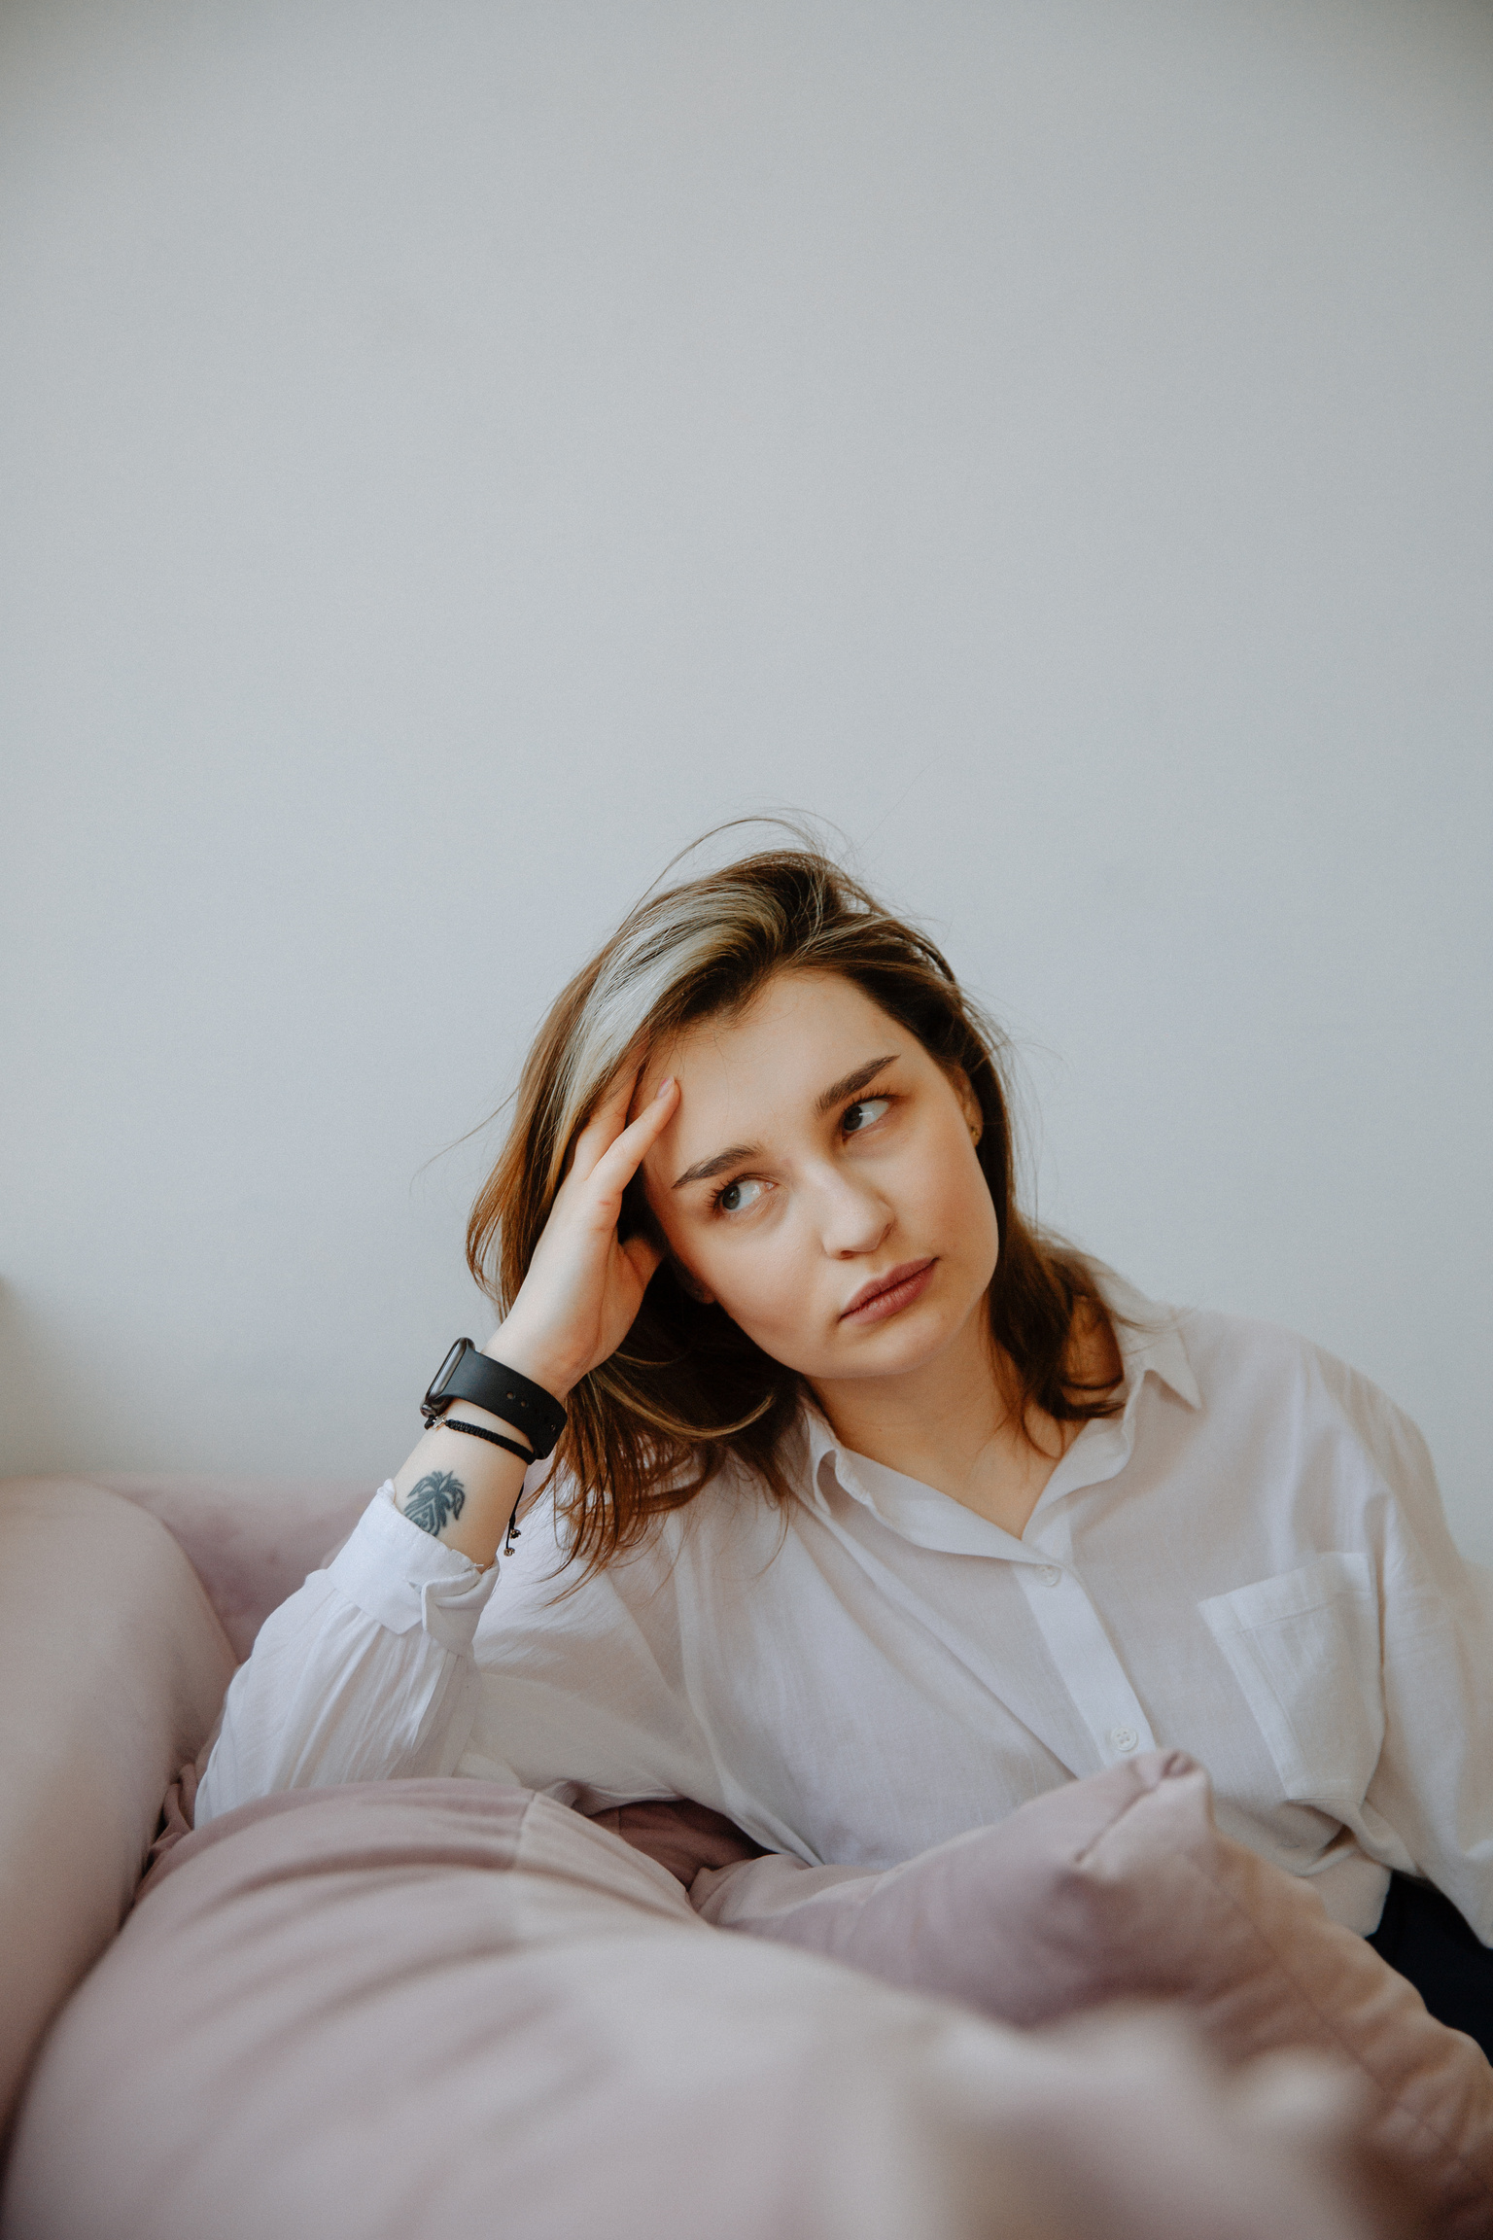
She _______________ happy today.

Slide 17
She _______________ happy today.
isn’t

Slide 18

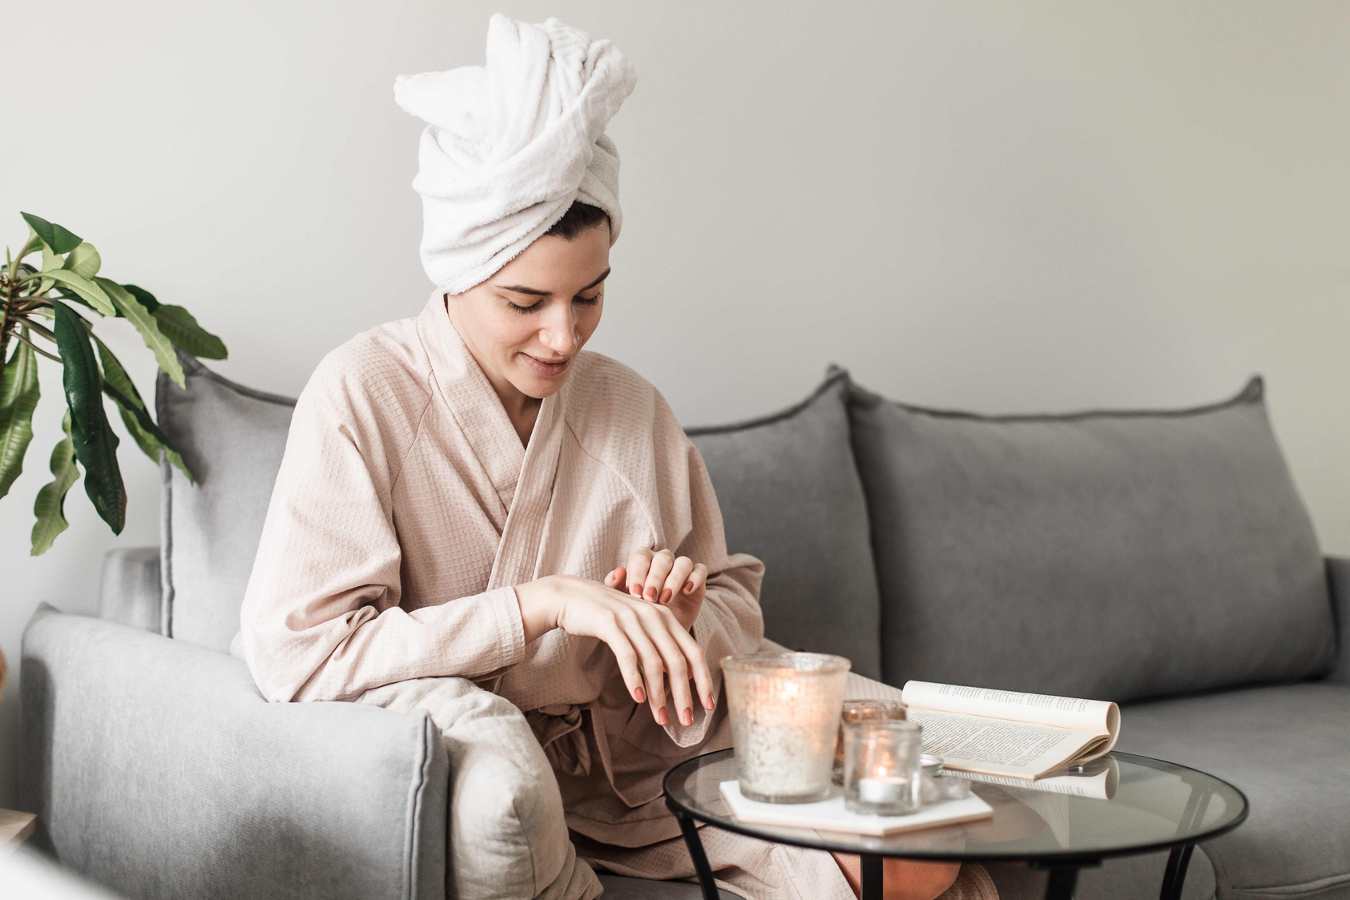
Olivia ________________ at home.

Slide 19
Olivia ________________ at home.
is

Slide 20
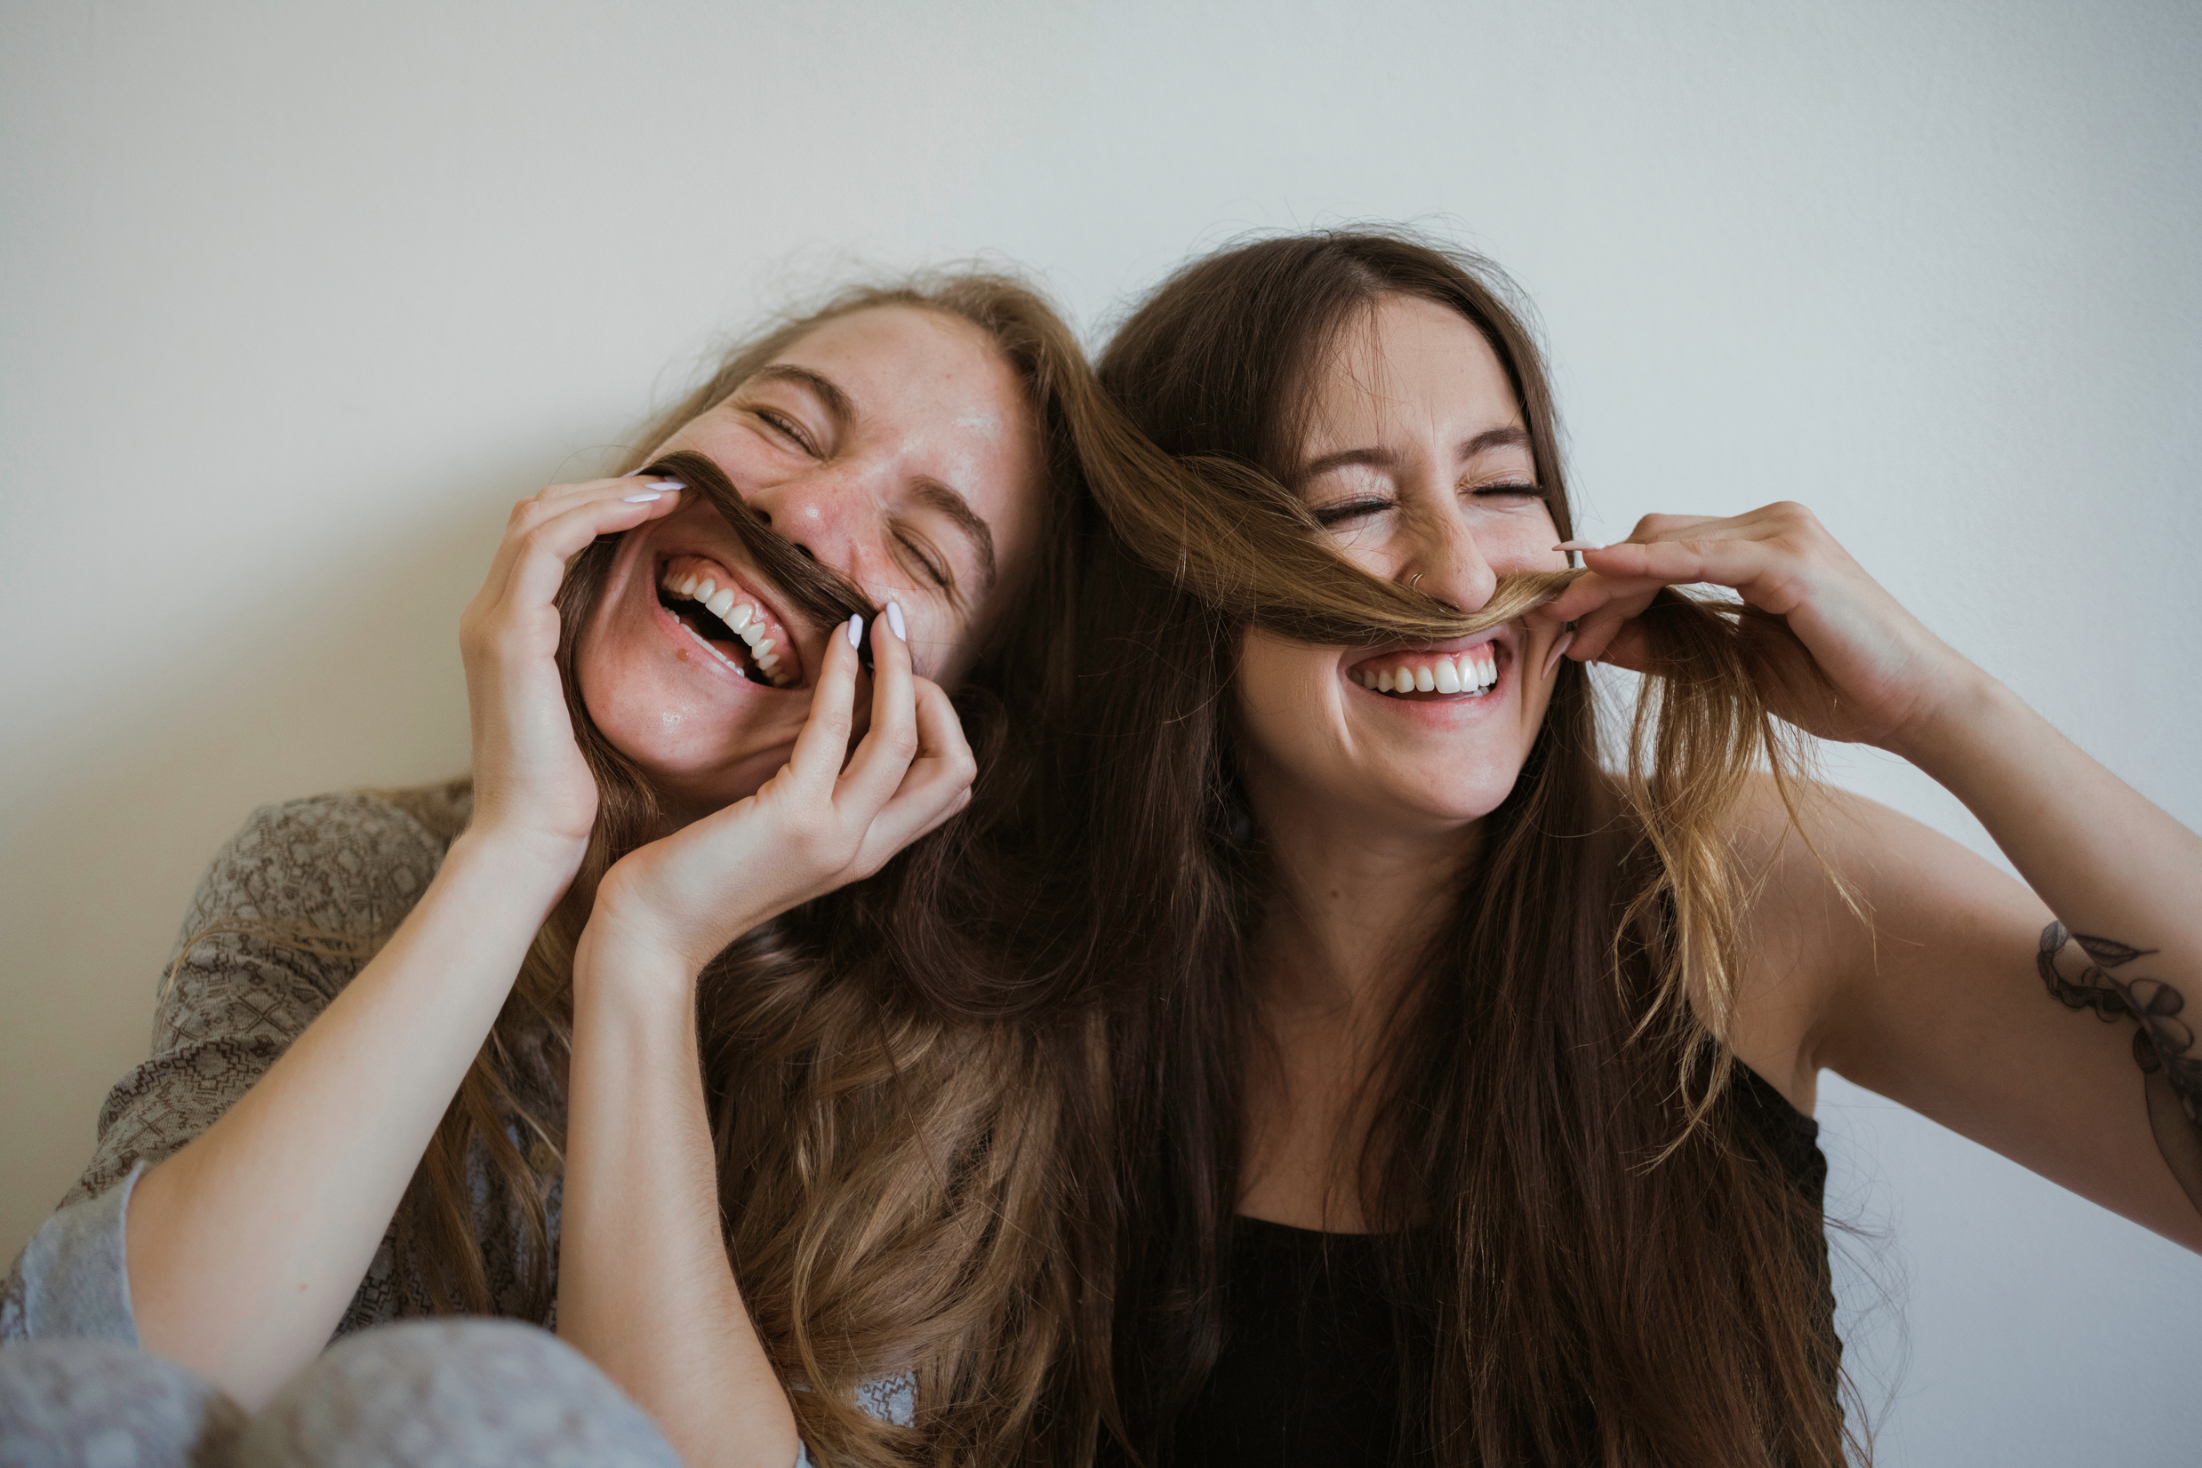
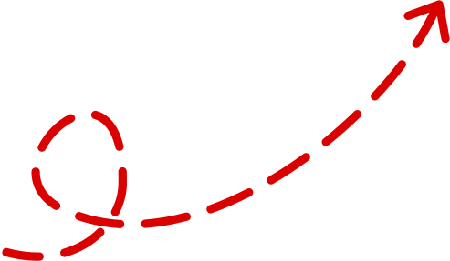
They _______________ friends. They´re sisters.

Slide 21
They _______________ friends. They´re sisters.
aren’t

Slide 22
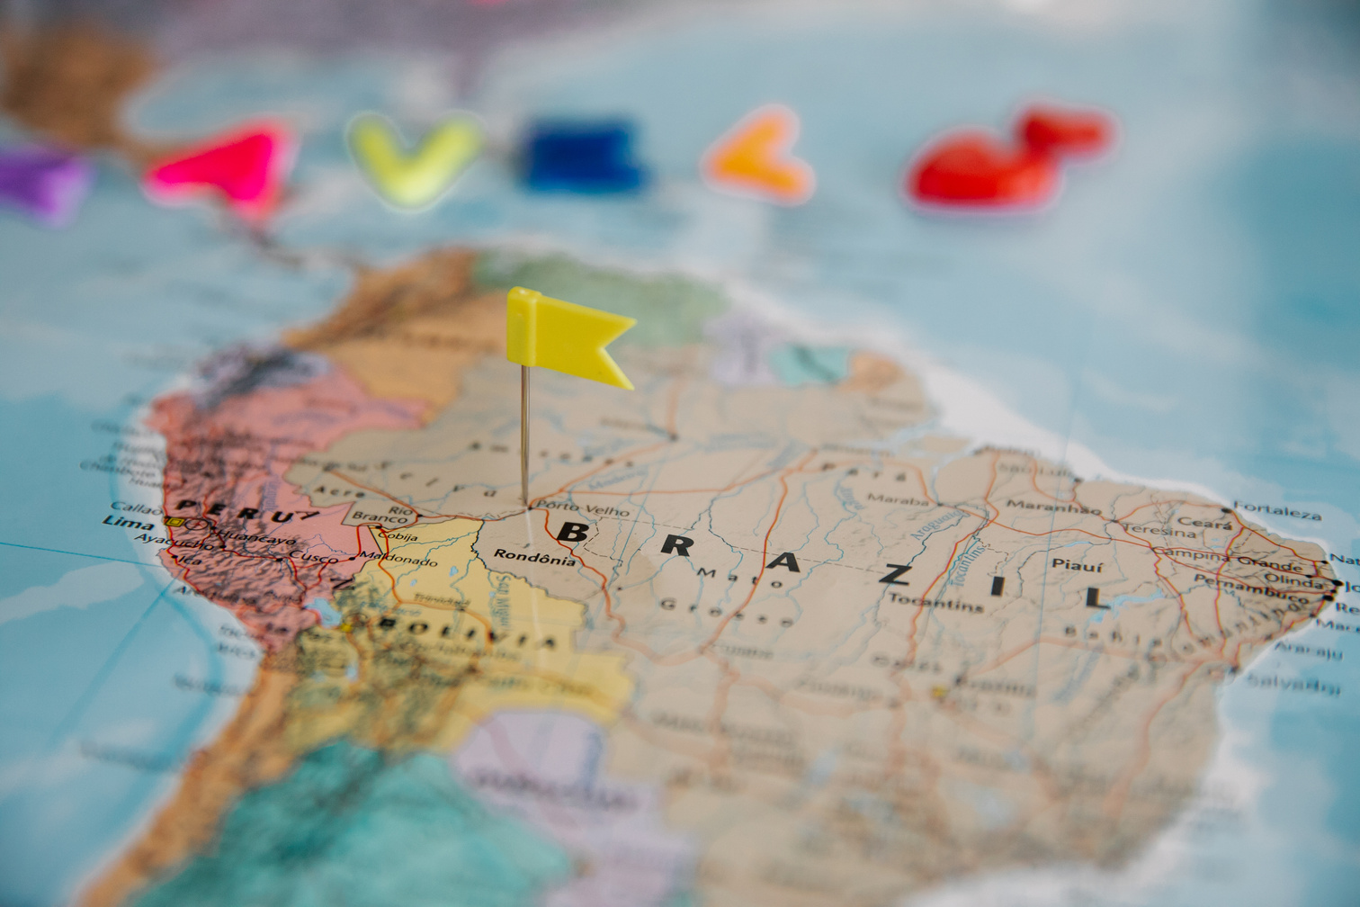

I _______________ from Argentina. I_________ from Brazil.

Slide 23
I _______________ from Argentina. I ________ from Brazil.
am not
am

Slide 24

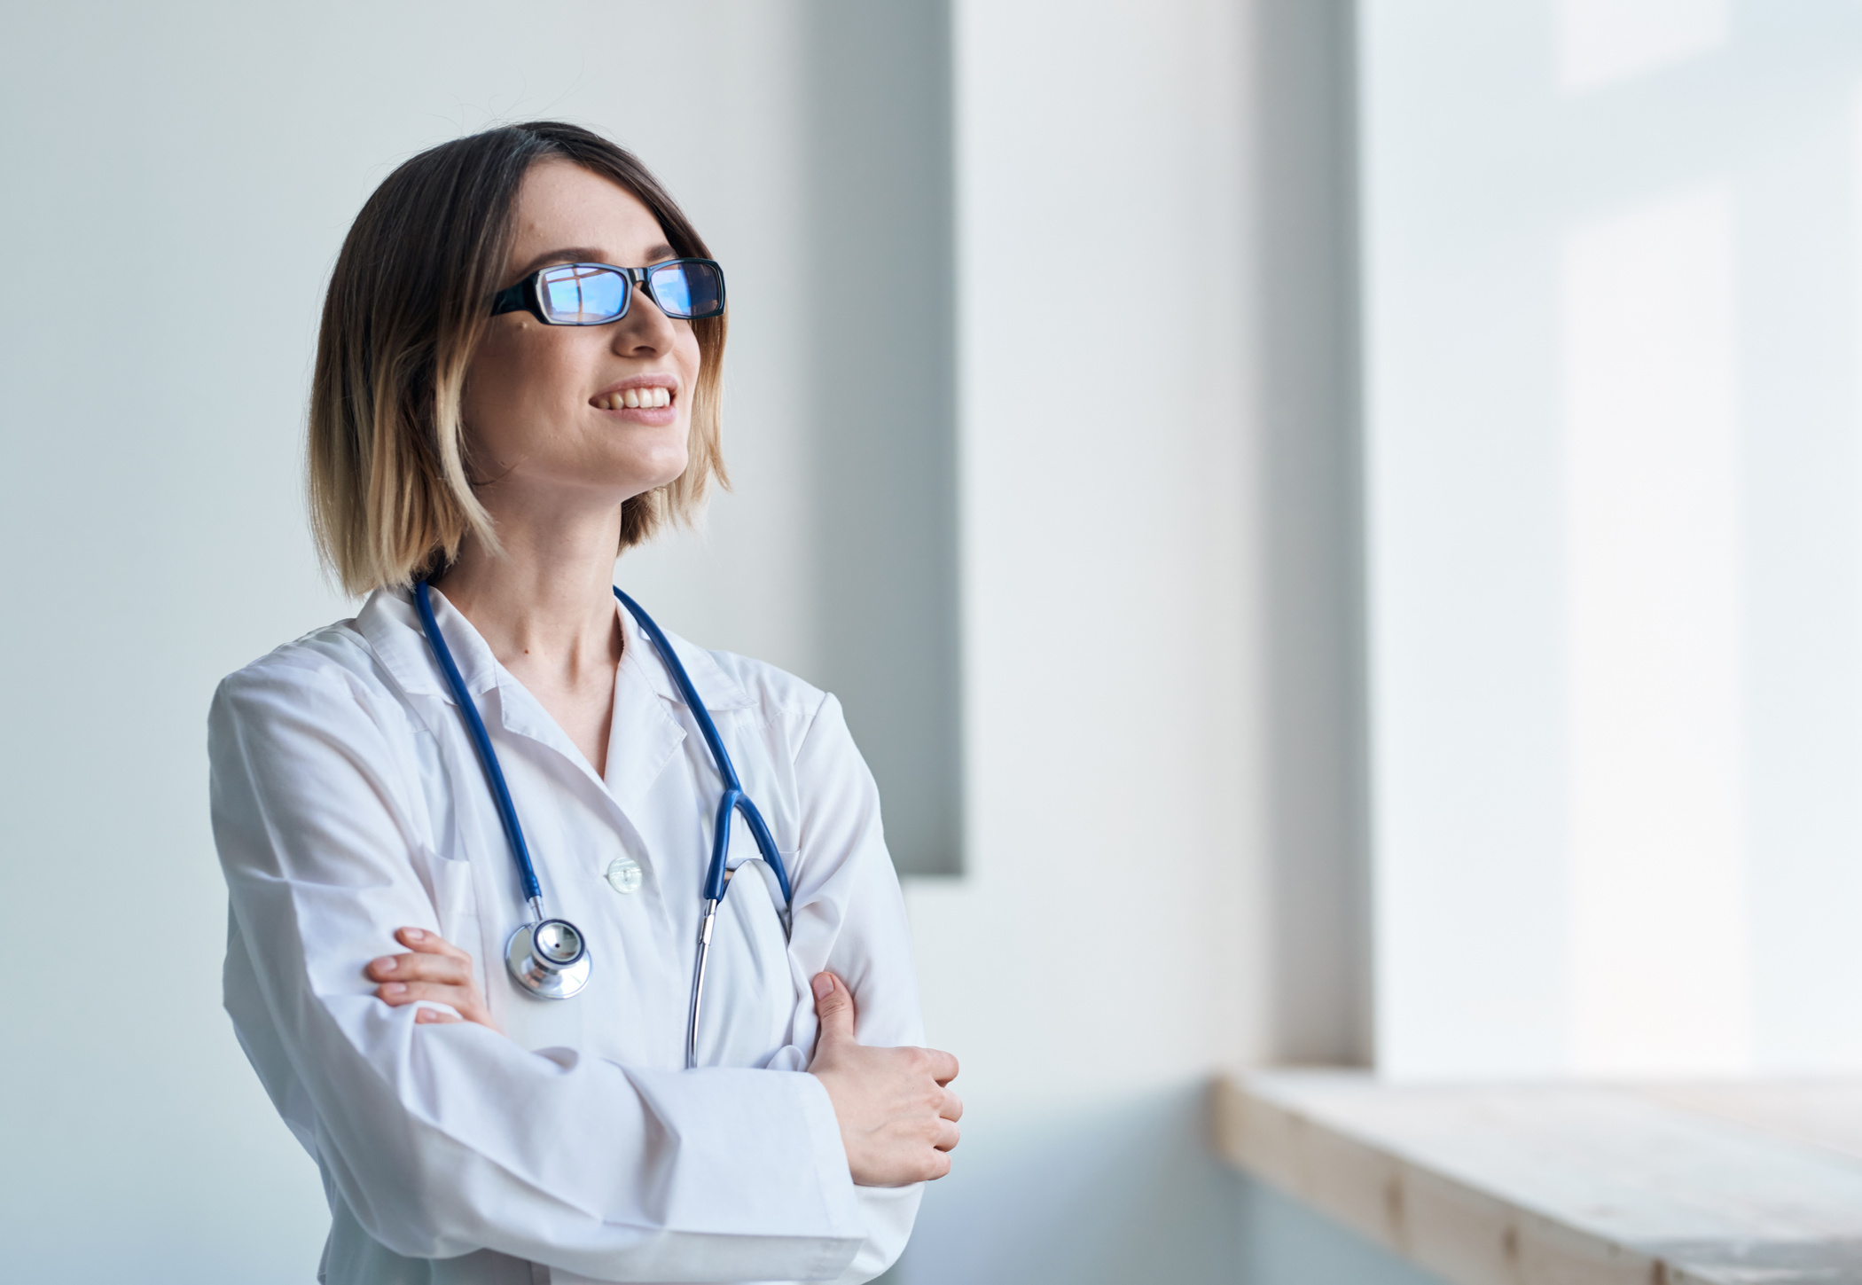
___________ your mum a doctor?
Yes, she __________

Slide 25
___________ your mum a doctor?
Yes, she __________
Is
Is

Slide 26


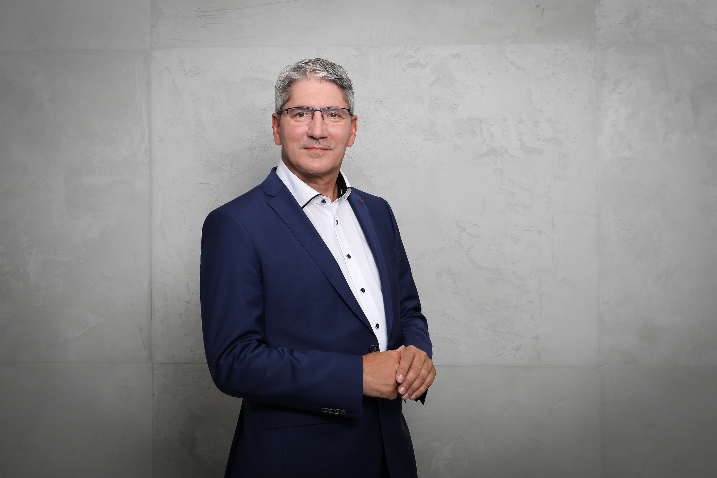
__________ you a business man?
Yes, I _____________

Slide 27
Are
__________ you a business man?
Yes, I _____________
am

Slide 28
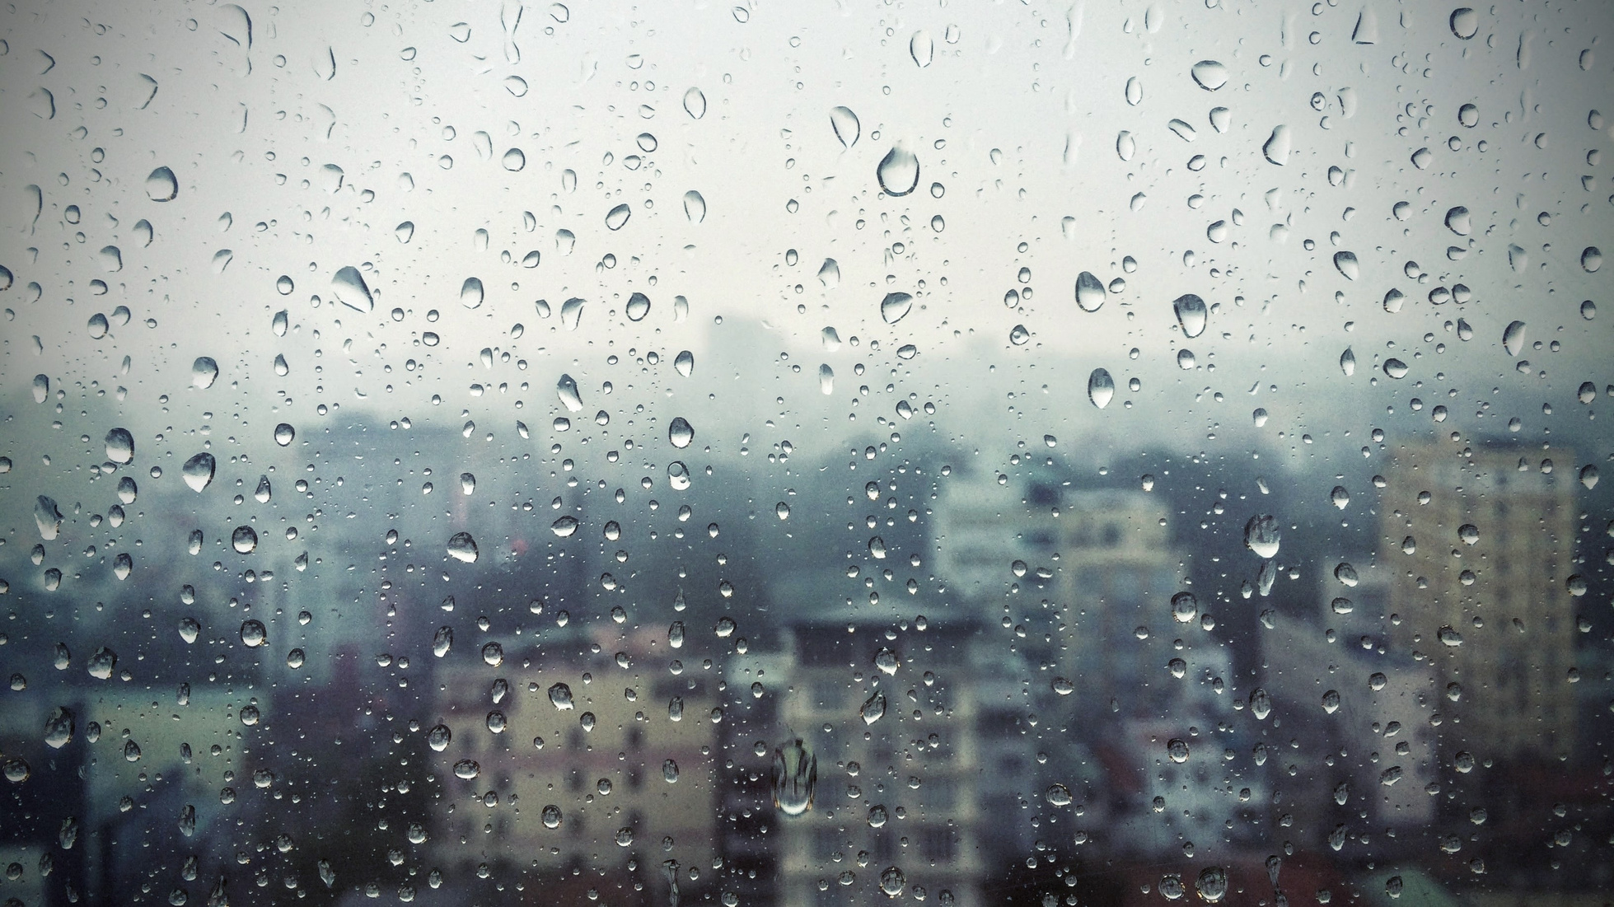

__________ it sunny today?
No, it _____________

Slide 29
Is
__________ it sunny today?
No, it _____________
isn´t

Slide 30



Possessive adjectives
Portuguese
meu/ minha
seu/sua
dele
dela
dele(a)
seus/suas
nosso (a) (s)
Deles (as)
My
Your
His
Her
Its
Your
Our
Their
I ´m
´s
´re

Slide 31
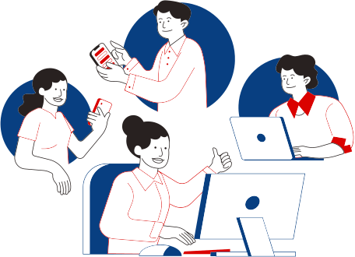
Great job!

